Slide 1
Introduction to Affective Computing
Professor Beste Filiz Yuksel
University of San Francisco
CS 686/486
Inspired by Prof. Rosalind Picard’s Affective Computing class https://ocw.mit.edu/courses/media-arts-and-sciences/mas-630-affective-computing-fall-2015/

Slide 2
What is Affective Computing?
Affective Computing is the study and development of systems and devices that can recognize, interpret, process, and simulate human affect/emotion.

Slide 3
Motivation – why emotions and computers?
Emotion is fundamental to human experience, influencing cognition, perception, and everyday tasks such as learning, communication, and even rational decision-making. However, while computers cannot detect, respond to, or simulate affect, they remain crippled in the ways that they can respond intelligently and efficiently to humans.

Slide 4
Motivation
“The question is not whether intelligent machines can have any emotions, but whether machines can be intelligent without any emotions.”
— Marvin Minsky (1927–2016) (Co-founder of AI Lab at MIT, Turing Award winner (most prestigious award in Computer Science)).

Slide 5
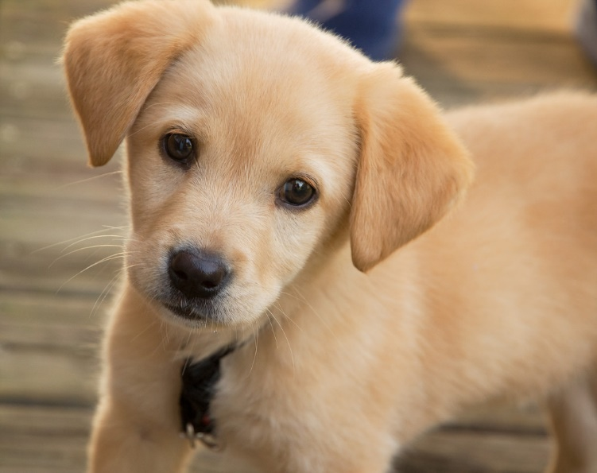
Which one is more intelligent?
Even a puppy can tell when you are angry with it.
(Nicholas Negroponte, Being Digital)
Notes:
Suppose someone is terribly upset – you gleefully respond ‘I understand!’

Slide 6
Computer will keep showing you the same data, whether you look like this, or like this

Slide 7
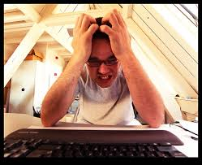
As a human, how would you respond to this?
Courtesy of Sybren Stuvel on Flickr
https://www.flickr.com/photos/sybrenstuvel/2468506922

Slide 8
How should a computer respond to this?
With this?
Courtesy of Sybren Stuvel on Flickr
https://www.flickr.com/photos/sybrenstuvel/2468506922
Notes:
Imagine you are at work and a character barges into the room and when you’re busy, doesn’t apologize, doesn’t ask, doesn’t notice that you are annoyed.
He offers you useless advice.
You express annoyance.
He ignores it.
This goes on.
Finally you tell him ‘go away’
He winks and does a little dance before exiting.

Slide 9
Human clippy
Imagine you are at work and a character barges into the room and when you’re busy, doesn’t apologize, doesn’t ask, doesn’t notice that you are annoyed.
He offers you useless advice.
You express annoyance.
He ignores it.
This goes on.
Finally you tell him ‘go away’
He winks and does a little dance before exiting.
- from Rosalind Picard, Affective Computing class

Slide 10
Intelligent expression by computers requires first recognizing affective context (and also considering goals & predicting outcome)

Slide 11
Human-Human Interaction
Human-Computer Interaction
Suppose that a person starts to give you help at a bad time. You try ignoring, then frowning at,
then
maybe glaring at him or her...
The smart person infers you don’t like this, ceases the interruption, notes the context, and learns from the feedback.
Suppose that a computer starts to give you help at a bad time. You try ignoring, then frowning at,
then
maybe glaring at him or her...
The smart computer infers you don’t like this, ceases the interruption, notes the context, and learns from the feedback.

Slide 12
But the computer wouldn’t frustrate people if it was only more intelligent?”
Consider:
“But the person wouldn’t frustrate people if he/she was only more intelligent?”
Fact: The most intelligent people are still
frustrating (at least sometimes).
People and computers can’t always prevent frustration. Thus, they should be prepared to handle it intelligently.

Slide 13
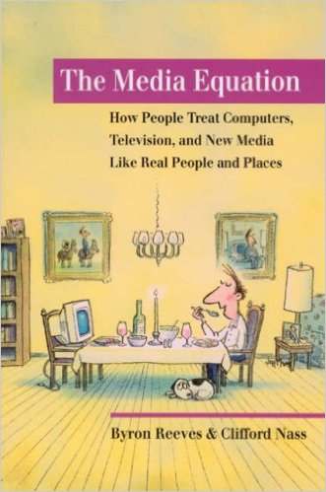
The Media Equation
Media = Real life
Individuals interactions with computers, televisions, and new media are fundamentally social and natural.
Everyone expects media to obey a wide range of social and natural rules – all these rules come from the world of human-to-human interaction. Expects these rules to pass into human-to-computer interaction.
Reeves and Nass, 1996

Slide 14
Media = Real Life
But Professor, I know my computer does not have emotions.
I can distinguish between life on the screen and the real thing.
“It doesn’t matter, people respond socially and naturally to media even though they believe it is not reasonable to do so, and even though they don’t think that these responses characterize themselves.” Reeves and Nass, 1996 (p7)

Slide 15
Media = Real Life
Not anthropomorphism – people rationally know but people often live life mindlessly.
People are polite to computers
People respond to interpersonal distance similarly (e.g. faces close up versus further away on the screen)
People believe flattery given from computers –regardless of sincerity
Notes:
Give handout for Media Equation – with qs

Slide 16
Skills of emotional intelligence
Simulating emotion
Detecting emotion
Adapting/Responding to emotion
Expressing emotions ->
Recognizing emotions ->
Handling another’s emotions ->
Regulating emotions
Utilizing emotions
(Salovey and Mayer 90, Goleman 95)
If “have emotion”
Notes:
You are going to build systems that do one or more of these things

Slide 17
Example – Simulating Affect
Emotional Intelligence (Ben Bloomberg) 404 Tumblr.com

Slide 18
Example – Simulating Affect
© Mendeley. All rights reserved.

Slide 19
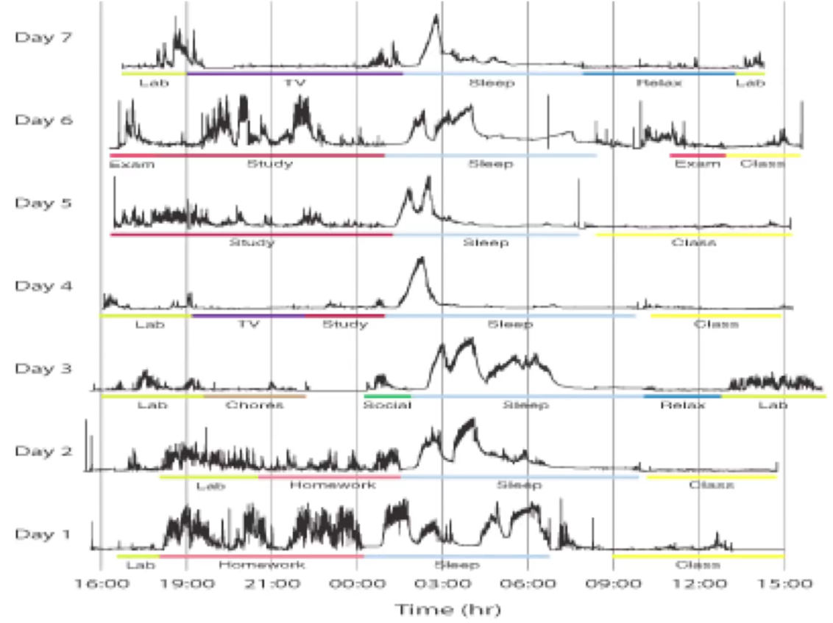
Example – Detecting Affect
Electrodermal activity (EDA) often increased by:
Significant thoughts
• Exciting events
• Exercise/breathing deeply
• Motion artifacts
• Humidity/moisture increase
• Lying
• Pain
As shown in TED Talk by Rosalind Picard https://www.youtube.com/watch?v=ujxriwApPP4

Slide 20
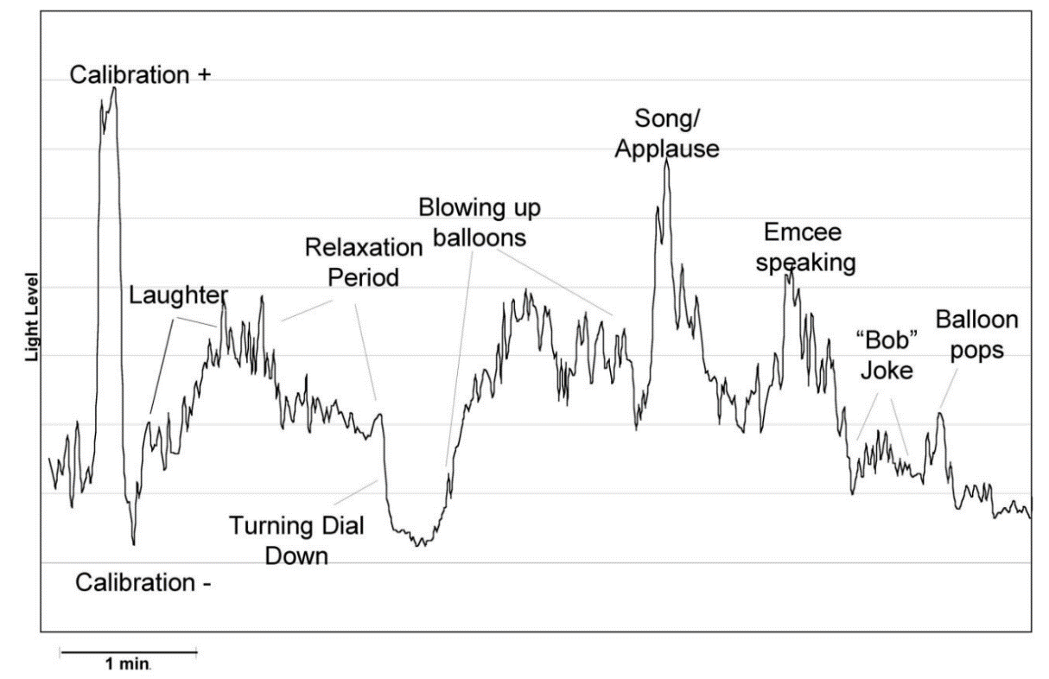
Example – Detecting Affect
www.media.mit.edu/galvactivator

Slide 21
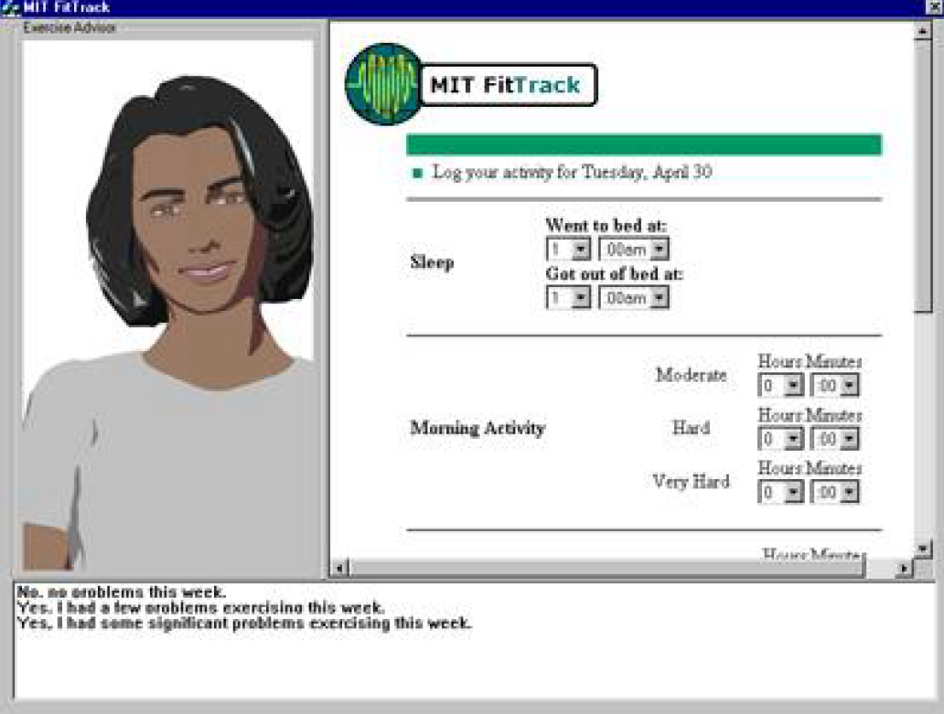
Example – Responding to Affect
Relational agent vs Non-relational agent
Users interacted with agent for a month,
both agents had same scripts, but relational
agent had other skills such as empathy.
Relational agent responded to affect, used small
talk, adjusted language over time, adjusted
social distance.
Bickmore, Timothy W., and Rosalind W. Picard. "Establishing
and Maintaining Long-Term Human-Computer Relationships."
Acm Transactions on Computer Human Interaction 12, no. 2
(2005): 293-327.

Slide 22
Example – Responding to Affect
"Laura and I respect each other." (p<.001)
"Laura and I trust one another." (p<.001)
"I feel Laura cares about me..." (p<.001)
"I feel Laura appreciates me." (p=.009)
"I believe Laura likes me." (p<.001)
Liking of Laura. (p=.007)
Desire to continue working with Laura. (p=.001)
Bickmore, Timothy W., and Rosalind W. Picard. "Establishing
and Maintaining Long-Term Human-Computer Relationships."
Acm Transactions on Computer Human Interaction 12, no. 2
(2005): 293-327.

Slide 23
Application Areas
Core topics:
Emotion and Learning
Emotion and Games
Emotion and Virtual/Relational Agents
Physiological Measurements of Emotion
Facial Expression Recognition
Elective topics:
Emotion and Music
Inducing Emotion
User Frustration

Slide 24
The Measurement of Emotion
Emotions give rise to changes that can be sensed:
Distance Face, voice
Sensing: Posture
Gestures, movement, behavior
Up-close Pupil dilation, Temperature, Respiration
Sensing: Skin conductance, ECG, EEG, Blood pressure volume, HR, HRV
Internal Hormones
Sensing: Neurotransmitters

Slide 25
The Measurement of Emotion
Emotions give rise to changes that can be sensed:
Distance Face, voice
Sensing: Posture
Gestures, movement, behavior
Up-close Pupil dilation, Temperature, Respiration
Sensing: Skin conductance, ECG, EEG, Blood pressure , HR, HRV
Internal Hormones
Sensing: Neurotransmitters

Slide 26
Demo time
http://www.affectiva.com/
Facial expression recognition software

